Slide 1
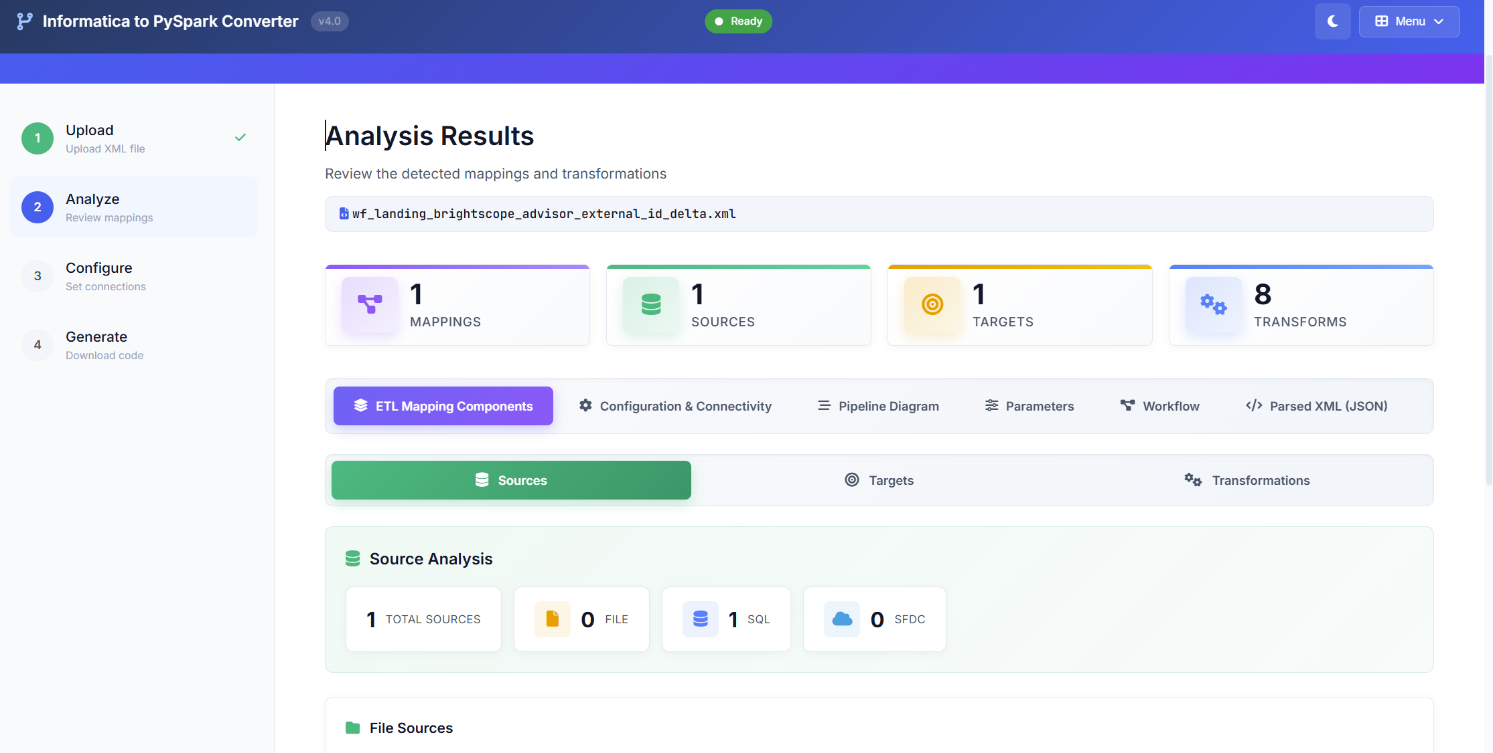
Informatica to PySpark Converter v4.0
Automated ETL code generation 70% automated conversion + 30% guided finalization and Speed, without sacrificing correctness.
Converts Informatica mappings into an initial PySpark ETL draft
Works with SQL Server for both input and output and Uses a standard configuration template
Covers common transformation patterns and business rules through automated translation
Includes performance-oriented defaults to support efficient processing after finalization
Delivers a complete package:)
Data Engineering Platform
@Nick Development Technical Presentation | 2026

Slide 2







Accelerating Informatica to PySpark Migration
70%
Informatica workflow
XML
Converted Pyspark
code
Automated Coverage
XML
PY
Auto-converts most Informatica mapping logic into PySpark draft code.
INFORMATICA
Informatica to PySpark
Converter
4-5 Hour
Time Saved/Mapping
Cuts manual rewrite time with faster analysis, code generation, and templating.
Converted Code
Compare Code
Code
Review
Code Testing
Code Deployment
30%
Speeds up ETL modernization by converting Informatica mappings into PySpark code drafts. Combines automation with guided finalization to ensure accuracy, control, and consistency across migrations.
Assisted Finalization
Reviewer-led tuning for edge cases, performance, and code readiness.

Slide 3
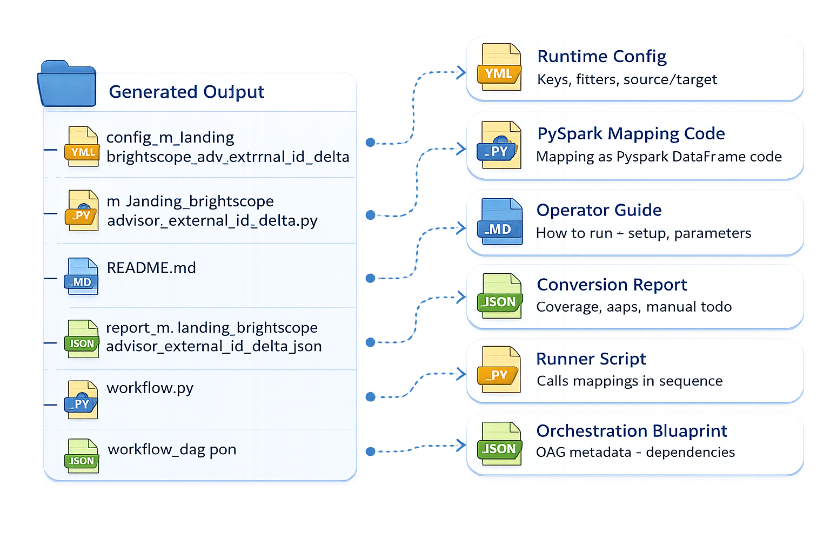

Generated Output Structure
The converter generates a PySpark ETL framework with code, config, and comprehensive validation report.

Slide 4




Modules & Capabilities
Modular design: each module handles specific conversion tasks from Informatica XML to PySpark.
PySpark Code Converter
Expression Converter
Improve Code Quality
Mapping Diagram
Auto-cleans generated code for production readiness. Applies formatting, best-practice refactors, performance hints, warnings fixes, and adds validations for safer execution.
Converts Informatica mapping/workflow XML into structured, runnable PySpark DataFrame code. Generates sources → transformations → targets flow with reusable templates, logging, and config-driven execution.
Translates Informatica expressions into equivalent PySpark SQL / DataFrame functions. Supports common functions like IIF, DECODE, NVL, SUBSTR, TO_DATE, ADD_TO_DATE with datatype handling and null safety.
Creates a visual diagram of the Informatica mapping flow. Shows sources → transformations → joins/lookups/aggregations → targets, making review, debugging, and sign-off faster.

Slide 5
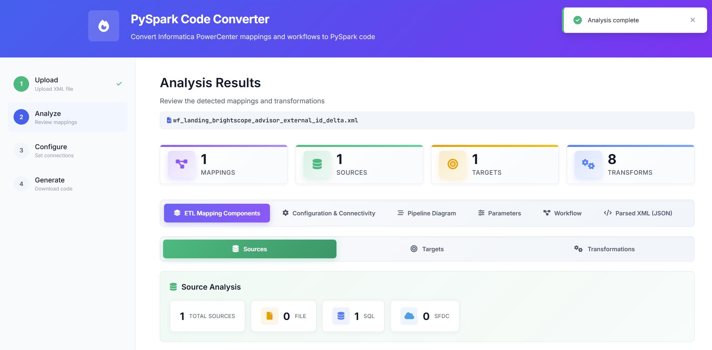
Informatica Xml Analysis

Slide 6
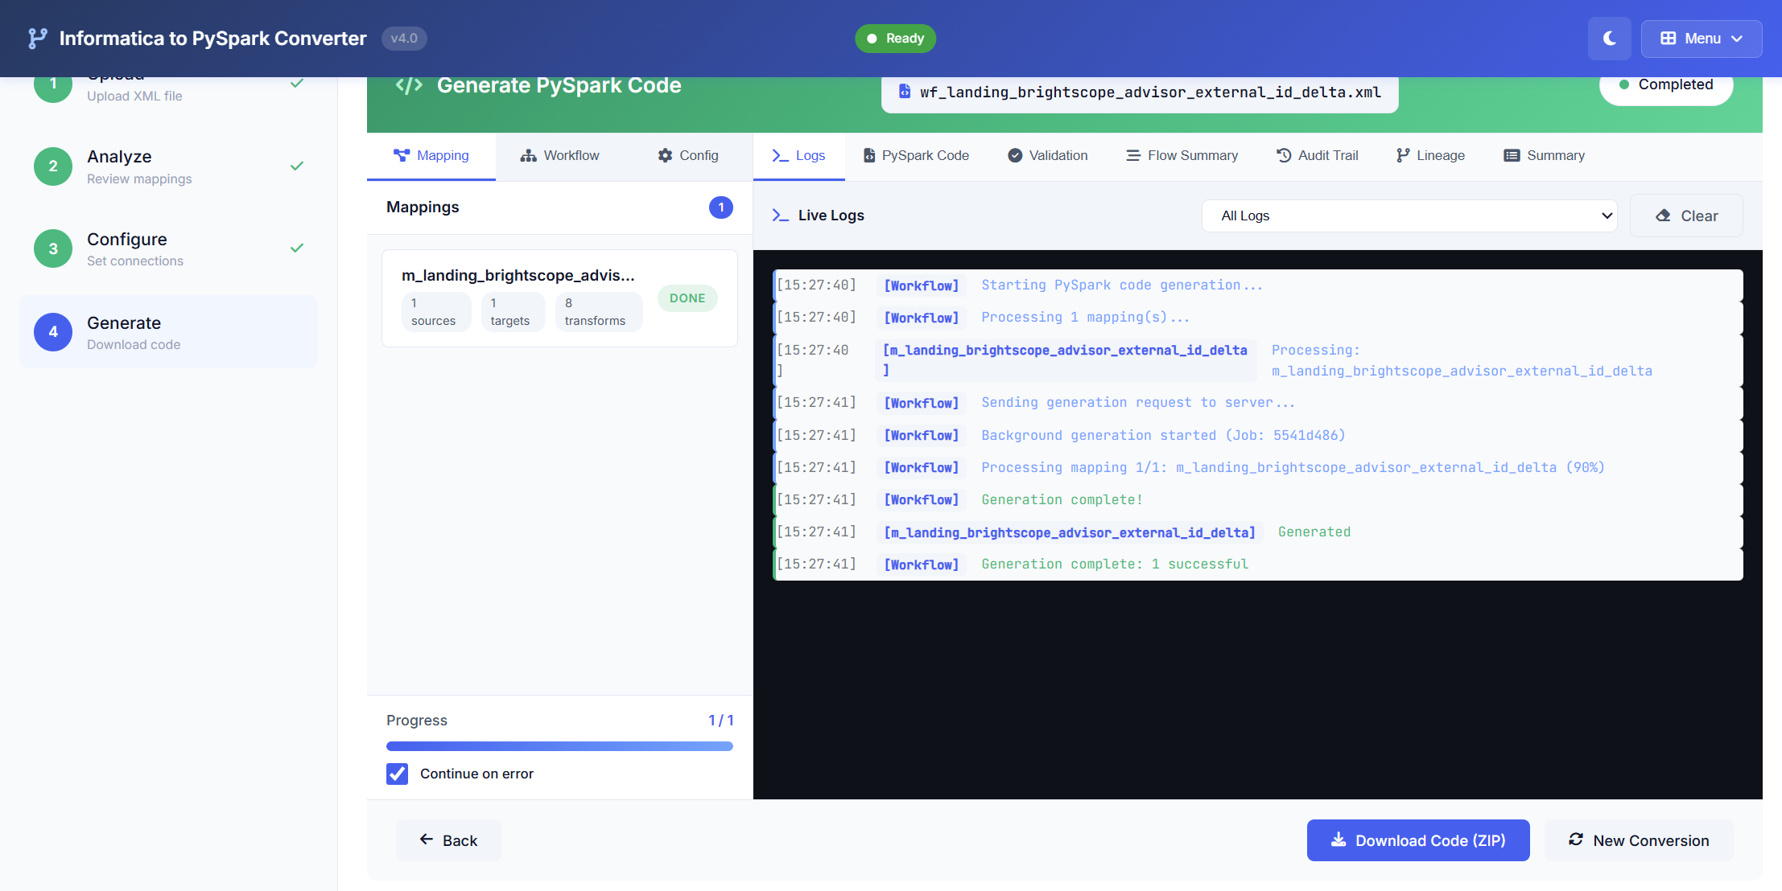
Generate PySpark Code

Slide 7
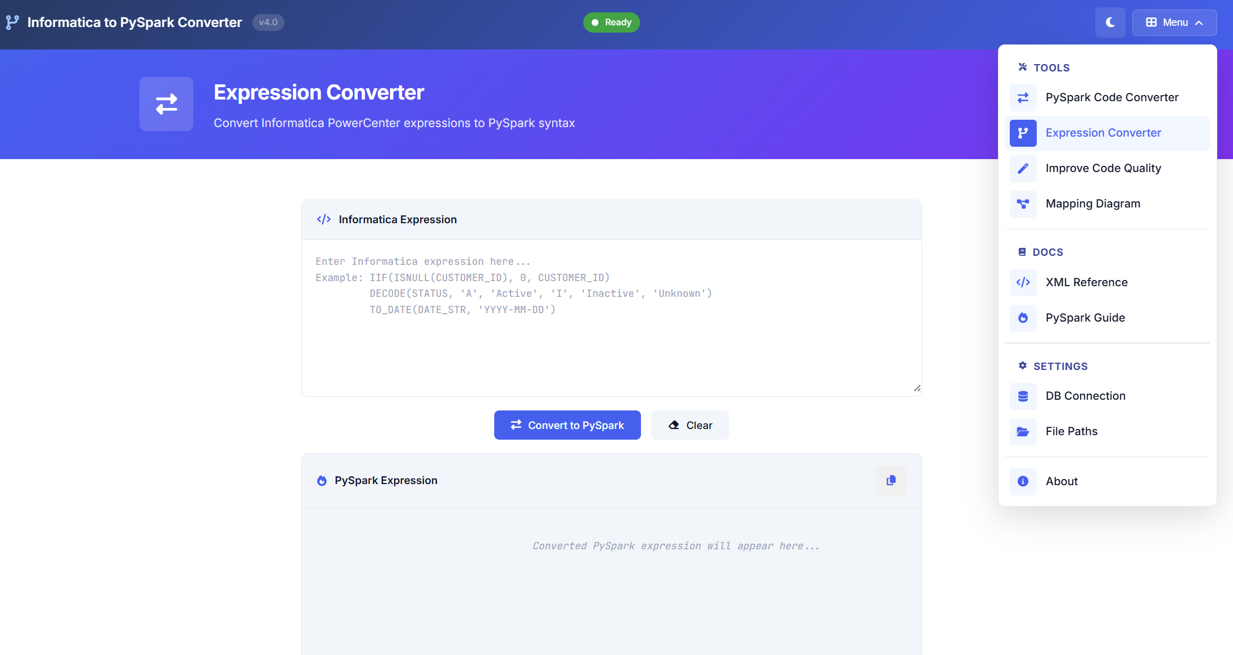
Expression Converter

Slide 8
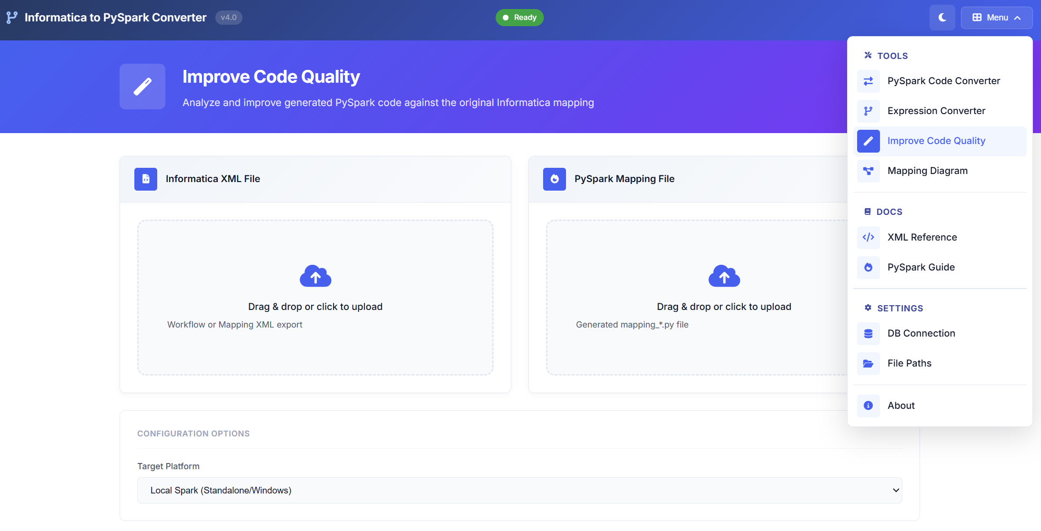
Improve code Quality

Slide 9
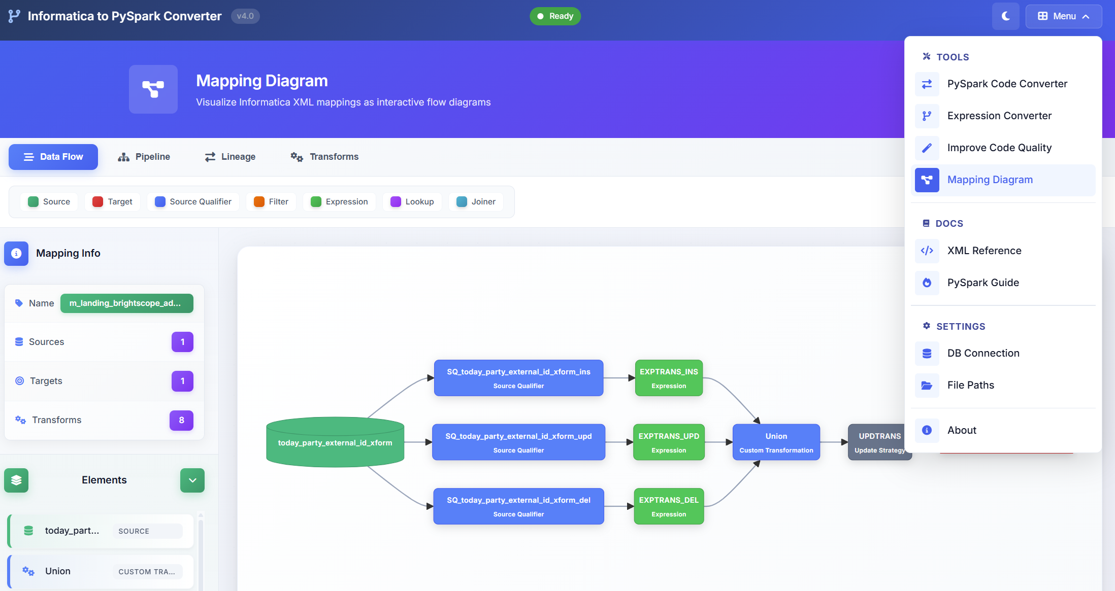
Mapping Diagram

Slide 10
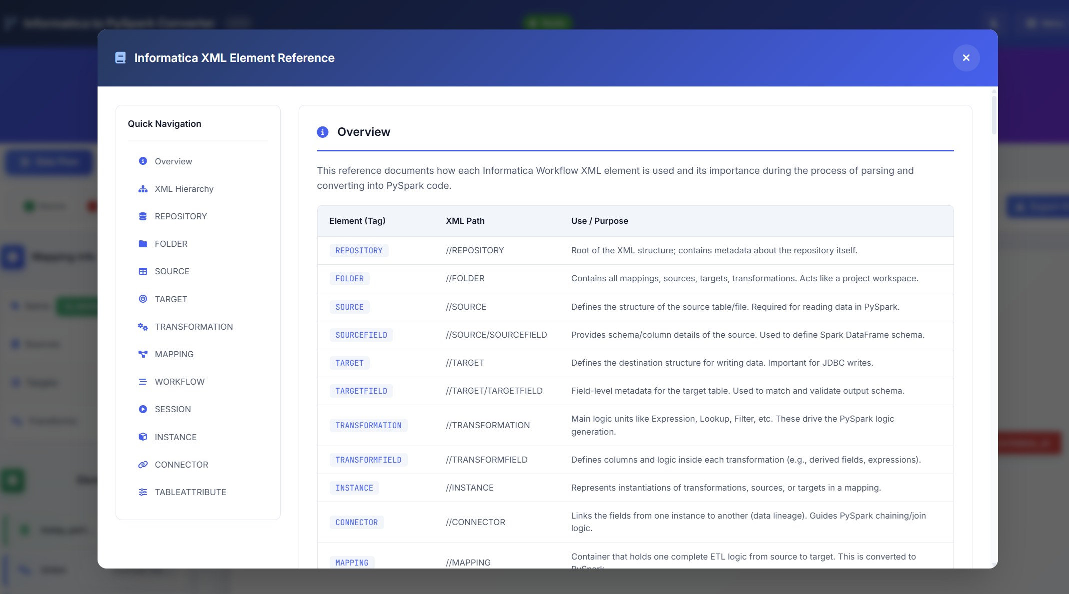
Informatica xml element DOC

Slide 11

Informatica xml element DOC

Slide 12
Workflow Orchestration + Demo + Roadmap
1
1. Start: Pilot Mapping
Select 1–2 mappings of varying complexity (simple filter, complex expression).
2
2. Convert & Review
Run converter → review report.json for warnings + TODOs → 70% auto-generated, 30% guided.
3
3. Validate & Tune
Schema check, row-count match, sample reconciliation. Resolve TODOs via Expression Converter.
4
4. Deploy + Iterate
Schedule PySpark job via Airflow/Databricks. Monitor performance. Add rules for future mappings. Continuous improvement.

Slide 13

Thank You — Questions?
Next: Start with a pilot mapping. The converter will show you exactly which patterns automate cleanly (70%) and where your expertise adds value (30%)

